Slide 1
DAF GEMSS
Cisco License Central (CLC) Tool
U.S. DEPARTMENT OF THE AIR FORCE
Global Enterprise Modernization Software & Support (GEMSS) Quarterly Business Review
August 2025
Notes:
The Cisco License Central (CLC) tool replaced the My Cisco Entitlements (MCE) tool as of 31 August 2025 for accessing Devices and Licenses assigned to Virtual Accounts. These slides provide some training to help understand how to use the major functions within CLC.

Slide 2
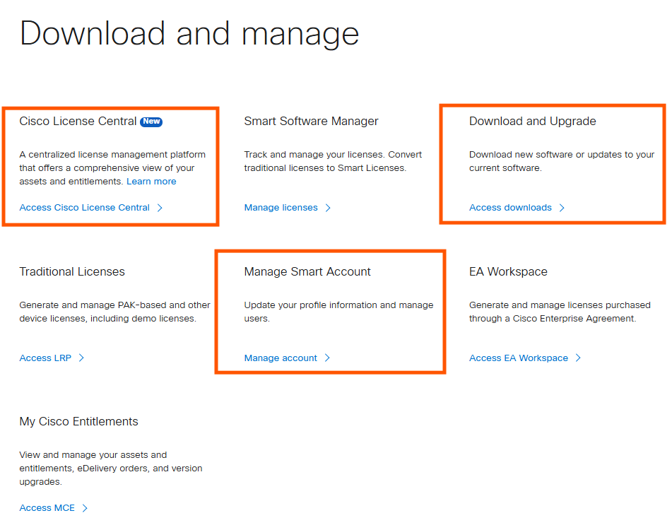
GEMSS Program Background
DAF GEMSS Program provides
Account, device, license, and user access for all DAF owned Cisco devices
Unlimited TAC support, defective device replacement, and software downloads for all Cisco devices
Unlimited licenses for Catalyst routers, switches, & wireless devices
Tools to manage devices, licenses, and users
  All tools are found at Cisco Software Central website: https://software.cisco.com
  1) Cisco License Central (CLC) – manages access to device and license information
  2) Download and Upgrade website – provides software downloads for all Cisco devices
  3) Manage Smart Account – manage account and user access
1
2
3
2

Slide 3
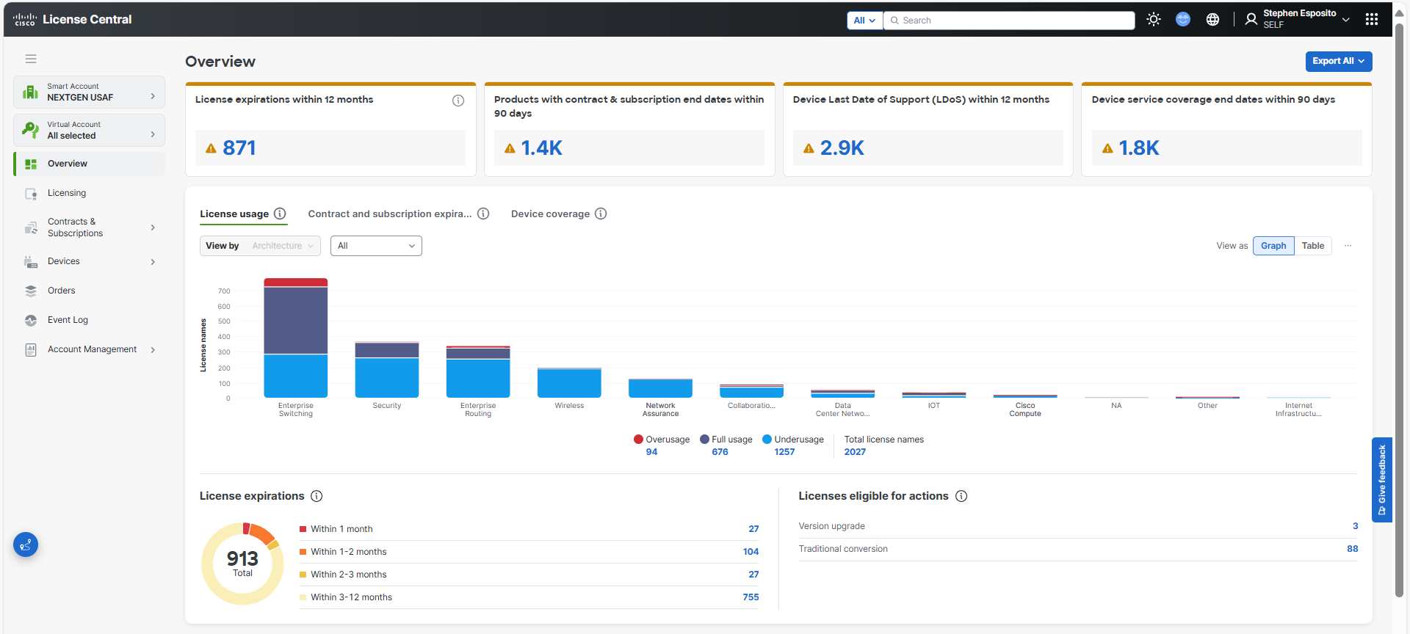

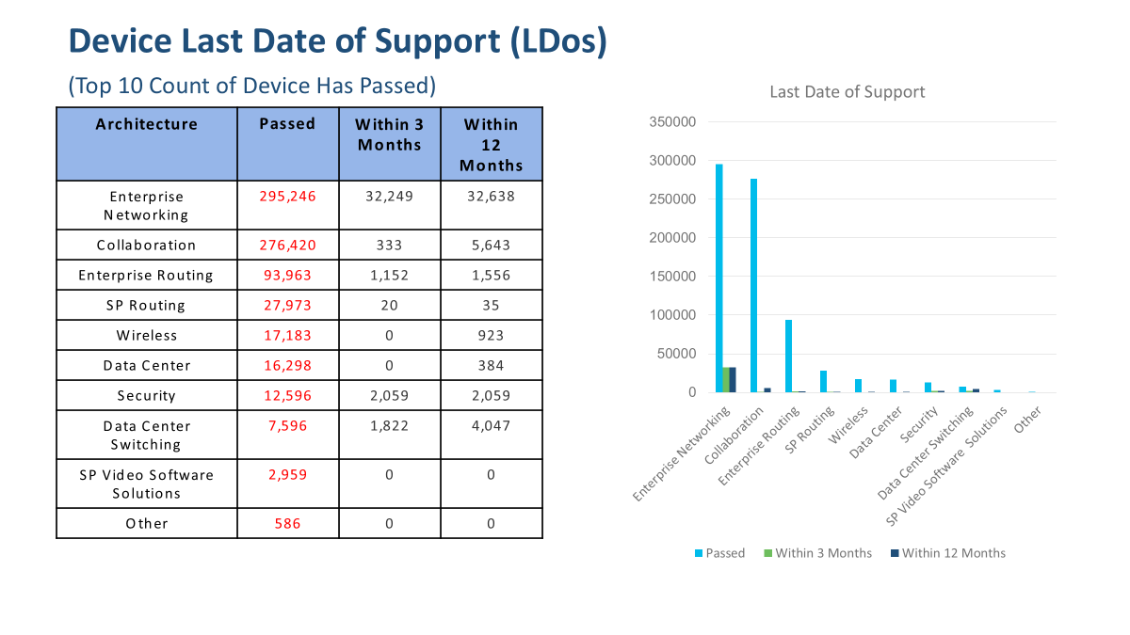
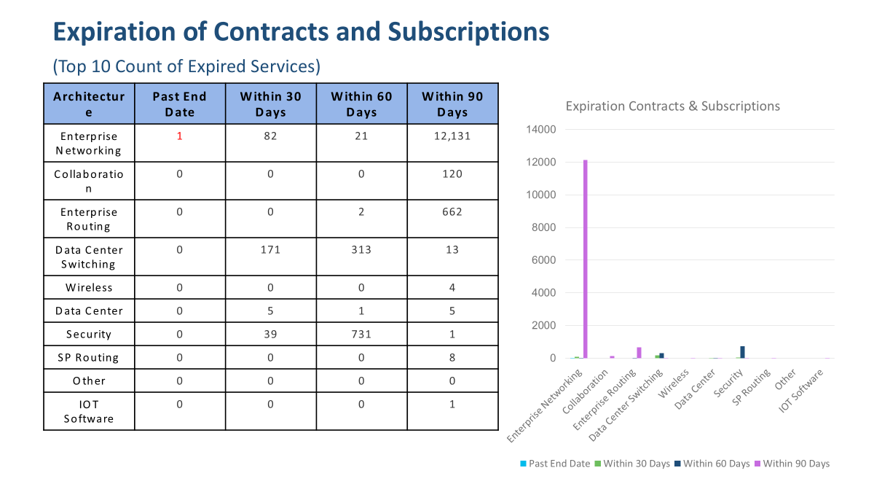
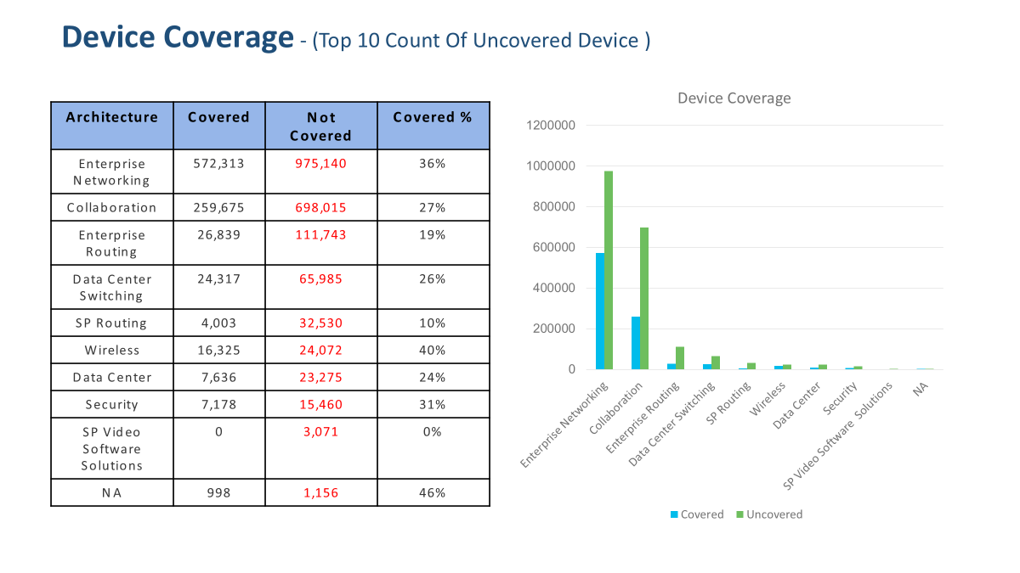
Cisco License Central (CLC) Overview
The CLC tool replaced the My Cisco Entitlements (MCE) tool to access Virtual Account device and license information
This is the default view when the CLC tool opens
  Overview section provides a summary of all selected accounts
  Export All button (top-right) allows the export of metrics into Power Point or Excel
2
1

Slide 4
Major CLC Functions
CLC provides access to view Accounts, Licensing, and Devices assigned to each Virtual Account
1) View all accounts
  Use checkbox to select or deselect accounts
  All accounts are selected by default
2) Licensing
  Licenses displayed are for selected accounts only
  Search available (e.g. License Name, account)
  Sort licenses by account
3) Devices
  Devices displayed are for selected accounts only
  Input a serial number in Search textbox to search for a device serial number
1
2
3

Slide 5
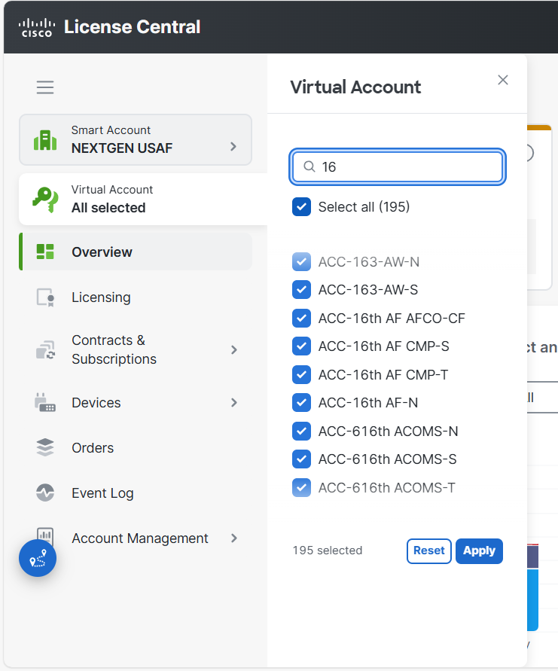
Selecting Virtual Accounts
By default, all accounts are selected
Enter partial account name to find any account containing the input
  E.g. 16 found ACC-16th AF-N and ACC-616th ACOMS-N
Select/deselect accounts using checkbox
Click apply button
Device listing will now only list devices contained in the selected accounts
Selected Virtual Accounts remain selected when using License and Device sections
2
1
3

Slide 6
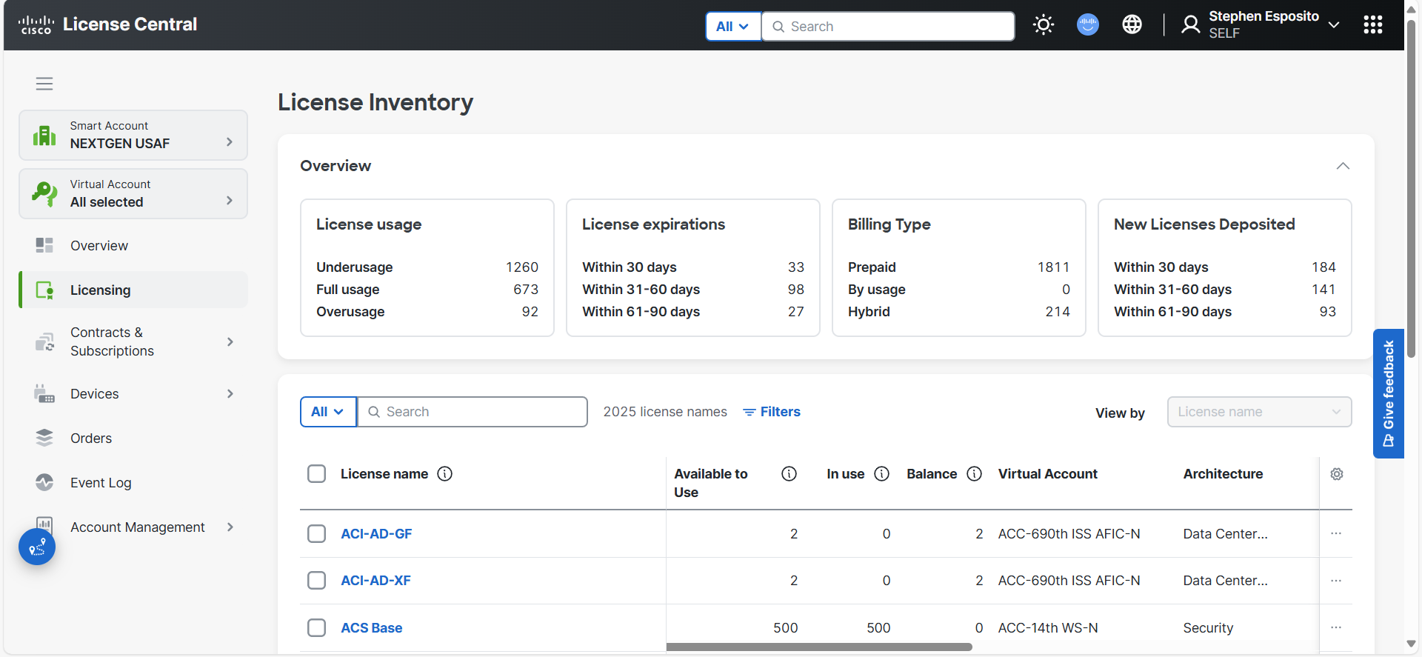
Listing Virtual Account Licenses
Use the Licensing section to display the license summary
Displays the licenses assigned to each of the selected Virtual Accounts
Search functionality permits finding licenses (e.g. DNAC, 9300) using a partial match in the search textbox
1

Slide 7
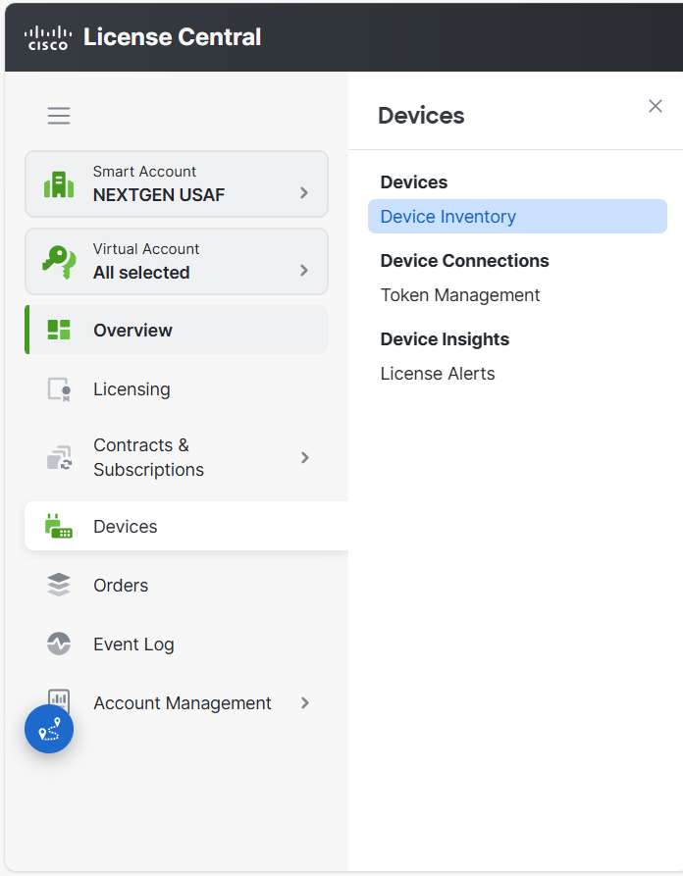
Listing Virtual Account Devices
Access all devices assigned to the Virtual Account through the Devices section
Choose Device Inventory from the push-out menu
By default, this will list all devices assigned to all selected accounts
2
1

Slide 8
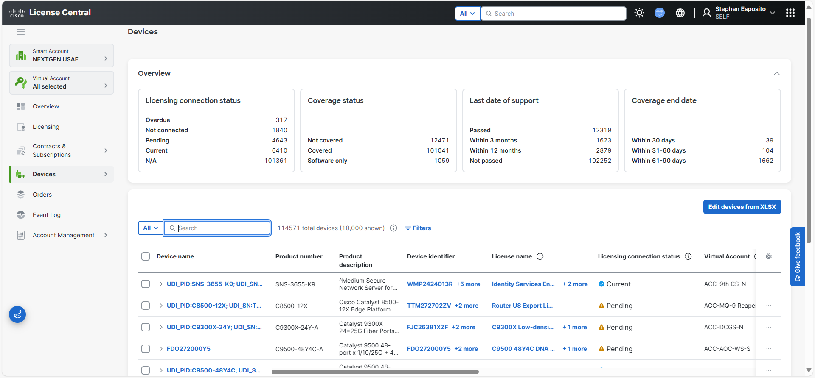
Searching for Specific Devices
Search function returns device records for criteria matching:
  Product number
  Product description
  Instance number
  Device identifier
  Contract number
  Customer name
  Customer site ID
  Sales order
  Purchase order
  Device name
  Licenses name
  Controller name
1

Slide 9
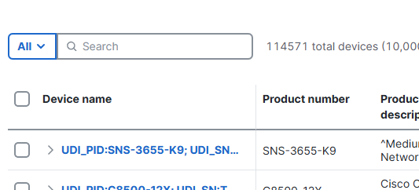
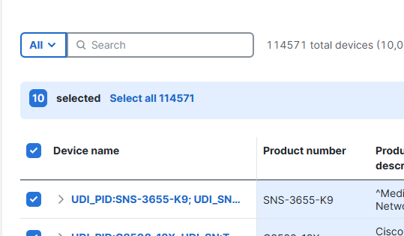
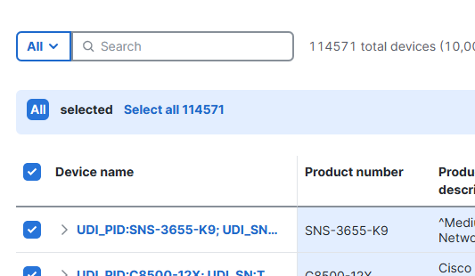
Selecting Devices to Export
1) Checkbox that selects one device
2) Checkbox that selects all devices on page
  10 devices are selected in the example
3) After selecting all devices on that page (2), choose Select All to select all devices on all pages
  114,571 devices are selected in the example
  Notice the arrows, the number selected increased from 10 to 114571
If search criteria was used, then the selected devices are only selecting the resulting device records
1
2
3

Slide 10
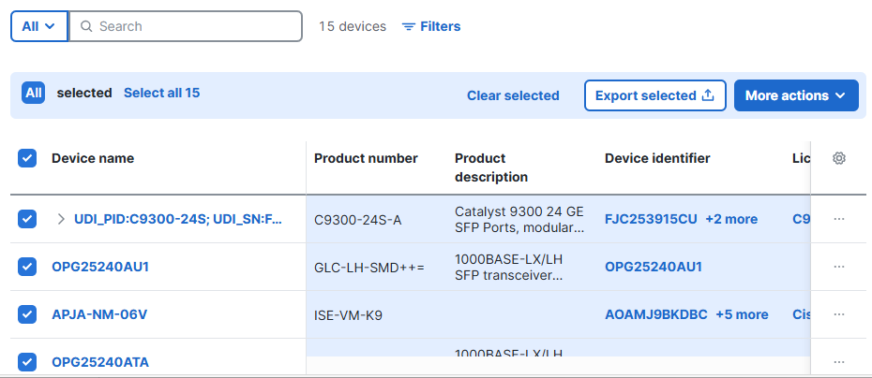
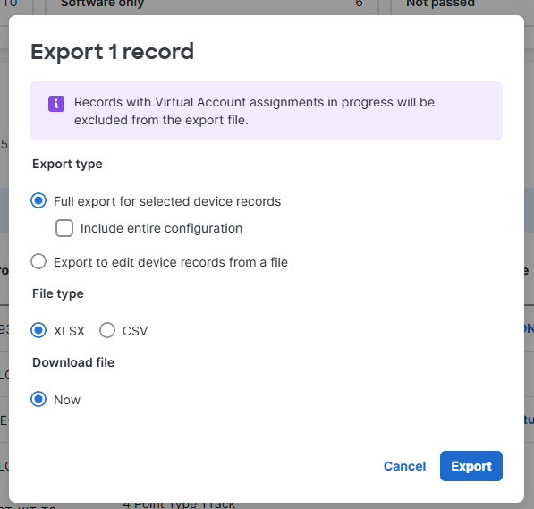
Exporting Selected Devices
After all devices are selected, click the Export Selected button (1)
Pop-up menu is displayed
2)Choose the output style
  XLSX = Microsoft Excel
  CSV = Comma Separated Values
3) Click the Export button to download the ZIP file
NOTE: Exported file provides 90+ columns of data for each device record
NOTE: Exporting 10,000+ device at once will produce large export files
1
2
3

Slide 11
Still Not Sure About CLC
Does the Unit need focused training? Does your team need personalized training? Do you need 1-on-1 training?
  Reach out to the GEMSS Team for live demo of the tool
Don’t suffer in silence
Contact the DAF GEMSS Team with any CLC issues
GEMSS@IronBow.com
DAF GEMSS Program Website:
Iron Bow Technologies | Air Force & Space Force GEMSS Program

Slide 12






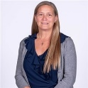



DAF GEMSS Team
Account Team (Sales)
GEMSS Support Team
Leadership, Strategy
    Eric R Younkin
    DAF HQ, ACC, CCC, PACAF, INDO
    eric.younkin@ironbow.com
    571-405-0148
    Steve Esposito
    GEMSS Director
    Stephen.esposito.1.ctr@us.af.mil
    stephen.esposito@ironbow.com
    571-324-1371
    Andrew D’Ippolito
    Vice President, Global Def Pgms
    andrew.dippolito@ironbow.com
    813-734-0330
    Drew Gerber
    ANG, AFRC, AETC
    drew.gerber@ironbow.com
    Mike Hart
    GEMSS Engineer
    michael.hart@ironbow.com
    703-674-5229
    Rob Watson
    Vice President, DoD Sales
    rob.watson@ironbow.com
    Mitch Levine
    USSF, AMC,SPACE/NORTH/USTC
    mitch.levine@ironbow.com
    240–418–3321
    Kelly Taylor
    GEMSS Cust Success Manager
    kelly.taylor@ironbow.com
    240-487-2196
    Max Houghton
    USAFE, CENT/SO/SOUTHCOM
    max.houghton@ironbow.com
    571-324-1293
    Monica Guevara
    Operations Manager
    monica.guevara@ironbow.com
    210-612-4501
    Steven Turner
    AFGSC, STRATCOM
    steven.turner@ironbow.com
    253-867-1833
    Mike Lydo
    Senior Manager, Software & Adoption Services
    mike.lydo@ironbow.com
    716-515-8547
GEMSS@IronBow.com

