Slide 1
Global Enterprise Modernization
Software & Support (GEMSS) Program
(SAF/CNS)
Notes:
Welcome to an introduction of the Department of the Air Force (DAF) Global Enterprise Modernization Software and Support (GEMSS) program. This program algins under SAF/CNS, covers SmartNet Total Care, and licensing for all DAF-owned Cisco Devices.

Slide 2
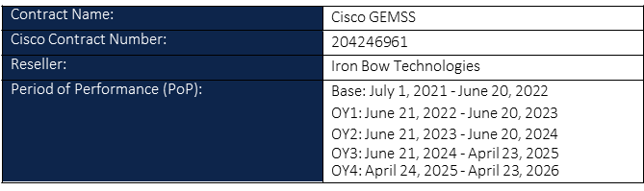
History – JELA to GEMSS
2008: USAF Sustaining Air Force Enterprise (SAFE) contract
2012: Army entered ESA w/Cisco to consolidate thousands of contracts/centralize Army support
2014 – 2021: DITCO entered into a Joint Enterprise Level Agreement (JELA) for all MILDEPS
2021: MILDEPS opted to enroll in the next gen Cisco enterprise agreement via GEMSS
Notes:
The GEMSS program was created after the Cisco JELA program concluded. Each Service created their own GEMSS program. The DAF GEMSS program began in July 2021. While the Cisco Enterprise Agreement contract will end its last option year in April of 2026, there is no anticipate gap in coverage. For awareness, this contract is Not an IDIQ contract to purchase Cisco devices but an Enterprise Agreement for Cisco services.

Slide 3
DAF GEMSS Overview
Cisco Enterprise Agreement
SmartNet Total Care:
24x7 Technical Assistance Center (TAC) for All Cisco device technical issues by phone and online portal
  Severity Code (S1-S4) assigned based on the severity of the outage
Unlimited replacement for All Cisco device failures (NLT next business day)
Unlimited Software Downloads for All Cisco devices
  Catalyst Center Centralized config management (virtual appliance option, AWS and VMware)
  GEMSS Enterprise Agreement Produced Over $215M in Cost Avoidance
Advantage tier licensing for Catalyst-based routers, switches, and wireless devices (excludes Nexus)
Advance Services Included:
5 dedicated Architects/Engineers assigned at DAF level (SAF/CNS) for Enterprise-wide support
High Touch Operations Management (HTOM) – prioritization of tickets
High Touch Technical Services (HTTS) – Supporting higher classifications
Asset management – Cisco License Central (CLC) Virtual Accounts, bulk adds/moves
Commonly Requested but Not Covered:
Cisco learning libraries and Base/field engineering support – Cisco Points or Scope Edge team
Cisco Identity Services Engine (ISE) – provides 802.1x, enables Comply to Connect, and enables Zero Trust
Cisco Nexus/FirePower/Call Managers Licensing – Only Catalyst device licenses are covered
NOTE: This is not an IDIQ contract to purchase Cisco equipment, but an Enterprise Agreement for entitlement to Cisco services
GEMSS Provides Cost Avoidance for Cisco Covered Device Purchases Regarding Software, License, and Support
3
Notes:
BLUF: The GEMSS program provides SmartNet Total Care and Advanced Services for all Department of the Air Force units. The GEMSS Program Ensures Future Purchases of Covered Cisco Devices Will Have Zero Cost for Software, License, and Support – because software, license, and support are an entitlement under the GEMSS program
When a network technician experiences an issue with any Cisco device, the first entitlement under SmartNet Total Care provides support with the Technical Assistance Center or TAC. This 24x7 telephone and online presence enables the network technician to document the Cisco device issue and work with a Cisco certified technician until the issue is resolved. A severity code is assigned to the TAC case based on the impact to the mission (S1 – critical impact, S2 – severely degraded impact, S3 – network is impaired, S4 – Informational/little to no impact).
If the issue cannot be resolved because the device is defective, then GEMSS provides device replacement. The TAC support team will work with the network technician to submit the paperwork to get a new device shipped. The GEMSS program ensure a replacement devices arrives no later than next business day, and if the TAC case is rated at S1 or S2, then this timeline will be accelerated (S1=4 hrs., S2 = 8hrs). The timeline is also dependent on geography (items but it’s hard to get a device to the middle of the Indian Ocean in one day).
The GEMSS program also enables the network technician to minimize cyber security risk with unlimited software downloads, which provides iOS updates, hot patches, and bug fixes for all Cisco devices. Additionally, Catalyst Center software (formerly known as DNA-Center) is a GEMSS entitlement, which provides a central management console to track, configure, update, monitor, and enumerate all Cisco devices on the network ecosystem.
All Cisco devices must be licensed to operate properly. The GEMSS Program provides licenses for all Cisco Catalyst and AireOS-based routers, switches, and wireless devices; Nexus data center licenses are not covered by GEMSS. Also, server and security appliance device licenses are not covered.
Under the Advanced Services, the Air Force has 5 dedicated network architect engineers assigned to Headquarters Air Force, under the Chief Information Office (SAF/CNS) at the Pentagon that directly supports enterprise-wide engineering efforts. For awareness, there is currently no Command or base-level engineering support, similar to the Cisco Points system, but if a Command or unit has a large project or engineering effort, the unit is encourage to bring the issue to the GEMSS Team for task prioritization. (NOTE: the unit should detail the project in an email and send it to GEMSS@IronBow.com).
The High Touch Operations Management, or HTOM team reads, processes, prioritizes, and monitors tickets to ensure the greater GEMSS support team remains engaged to resolve issues quickly and accurately, the first time. When devices are at a higher classification level than NIPRNet, the High Touch Technical Service or HTTS team will process and monitor these cases. The HTTS Team is cleared to Top Secret level to ensure proper handling of all information while the issue is being resolved.
The Asset Management team provides a way for units to easily add, move, and remove devices from their GEMSS account. This team is commonly used after devices are turned into DLA Disposition Services (formerly known as DRMO).
Some commonly requested items but are not covered by GEMSS are…Cisco Learning Library, Base or Field Engineering Support, Cisco ISE licensing, and, like previously mentioned, GEMSS does not cover Nexus data center licenses.
While the contract under the GEMSS program is not an IDIQ contract to purchase Cisco devices, it does provide a way for future purchases of Cisco devices to zero-out the cost for SmartNet Total Care (software, license, and support). If the quote does not show a zero cost, reach out to the GEMSS Team for support (email the details to GEMSS@IronBow.com).
======= ADDITIONAL INFO =======
Covered devices are replaced by the next business day but can be replaced within 4 hours of notification for Severity Code 1 TAC Cases and 8 hours of notification for Severity Code 2 TAC Cases. Accurate inventory in the GEMSS account is crucial so Cisco can posture proper replacement devices in the nearest warehouses to the Unit’s location. NOTE: Some geographic locations cannot be delivered to within this timeframe (e.g. island middle of the Pacific Ocean).

Slide 4
Smart & Virtual Account Layout
NEXTGEN USAF
*ACC
ACC-7th ASOS-N
ACC-14th WS-N
*AMC
AMC-18th AF-N
*AFMC
AMC-19th CS-N
AMC-22nd CS-S
AMC-EACN-N
PACAF-11th AF-N
PACAF-36th CS-N
ACC-20th CS-N
ACC-23rd CS-N
ACC-26th NOS – N
PACAF-354th CS-N
PACAF-15th CS-N
*USAFE
ACC-319th CS-N
375th CS-N
436th CS-N
AFMC-597th CS-N
AFMC-66th CS-N
AFMC-AFLCMC-EB-N
AFMC-AFLCMC-HNCO-N
AFMC-AFLCMC-N
AFMC-AFLCMC-TDC-N/S
PACAF-18th CS-N
PACAF-51st CS-N
*PACAF
USAFE-100th CS-N
USAFE-1st ACOS-N
USAFE-31st CS-ACE
USAFE-39th CS-N
USAFE-420th CS-N
USAFE-86th CS-N
SMART ACCOUNT
DAF Cisco Ecosystem
~650,000 Devices
~1,100 Virtual Accounts
~2,000 Users
PARENT VIRTUAL ACCOUNT
VIRTUAL ACCOUNTS
Notes:
This graphic represents the structure of the Cisco database that contains the devices and licenses. The GEMSS program utilizes one Smart Account, NEXTGEN USAF, with all other sub-accounts as Virtual Accounts. Each Command is assigned a Parent Virtual Account and their sub-accounts are the Units assigned to that Command.
Each unit may have multiple Virtual Account (e.g. one for NIPR, SIPR, and JWICS), and inside each of these Virtual Accounts are the devices assigned to the unit. There are PMOs with Virtual Accounts, and they are assigned to the Command where the predominance of their mission operates (e.g. EACN is assigned under AMC).
BE AWARE, devices must assigned to a Virtual Account, under the NEXTGEN USAF Smart Account to receive support (TAC, hardware replacement, software access, and licensing) under the GEMSS program. It’s equally important for the Unit’s network technicians to request access to their GEMSS account and verify all Cisco devices are listed in their account. This will ensure Cisco postures replacement devices nearby.

Slide 5
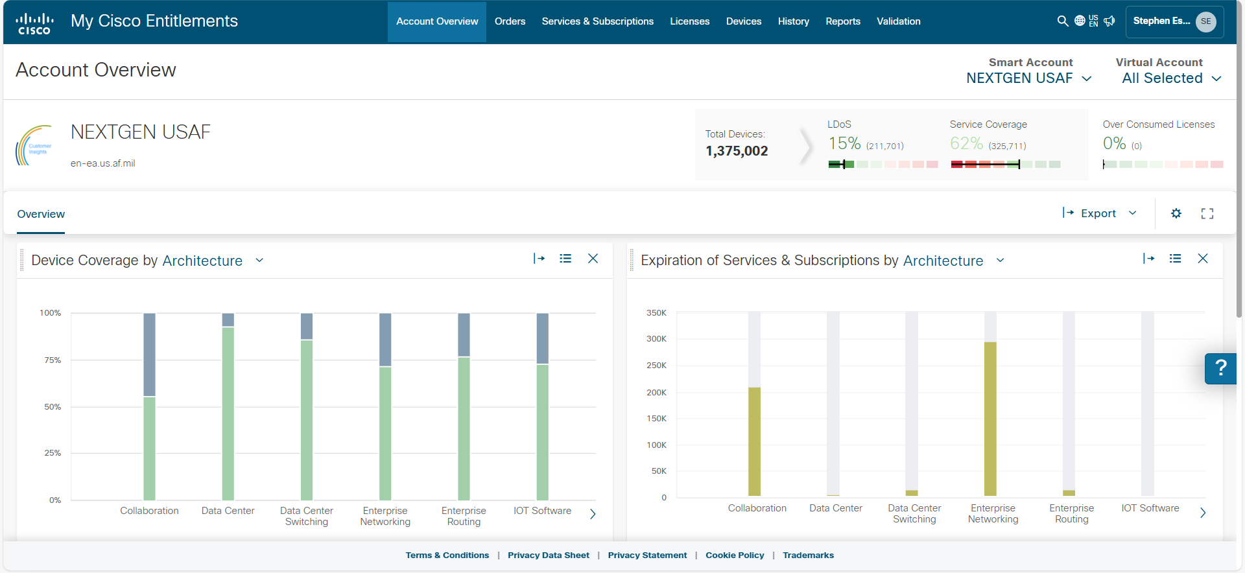
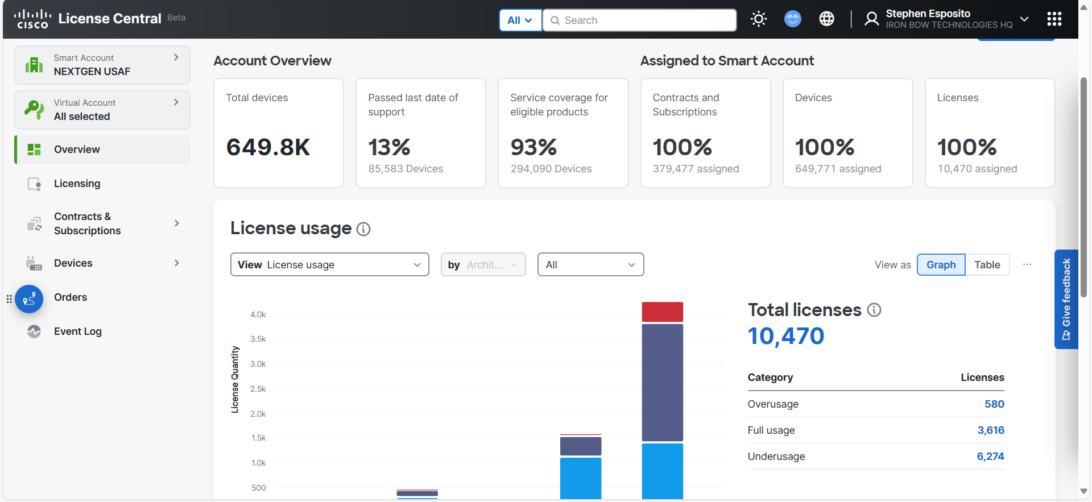
Cisco License Central Tool
Cisco Software Central
https://software.cisco.com
Cisco License Central (CLC) replaced My Cisco Entitlements (MCE) as of 1 Sept 2025
Notes:
The Cisco License Central (CLC) replaced the My Cisco Entitlements (MCE) tool as of 1 September 2025. It is the only tool to access devices and license information. The CLC tool can be access using the Cisco Software Central website: https://software.cisco.com

Slide 6
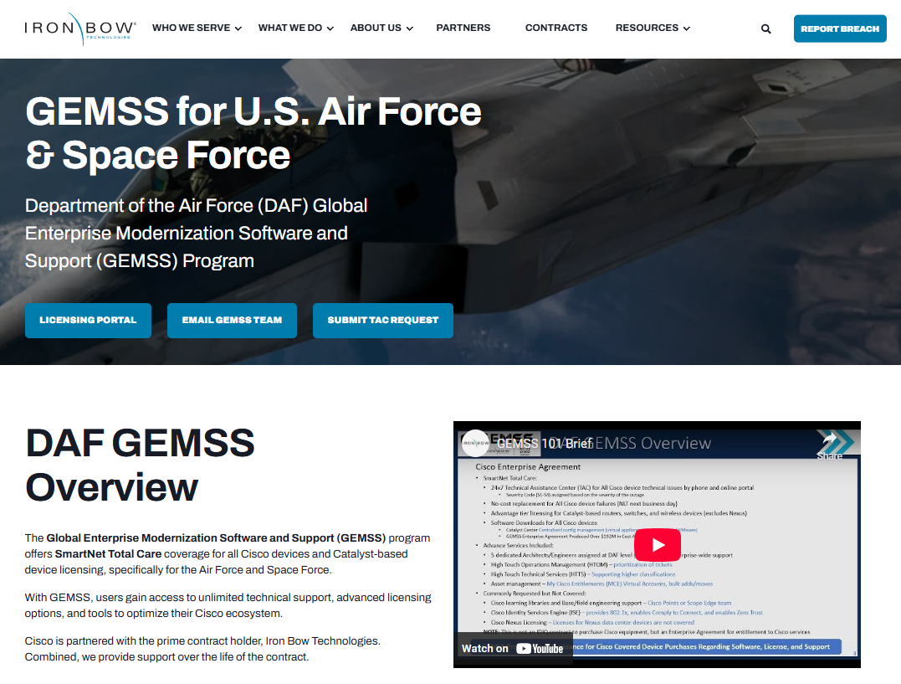
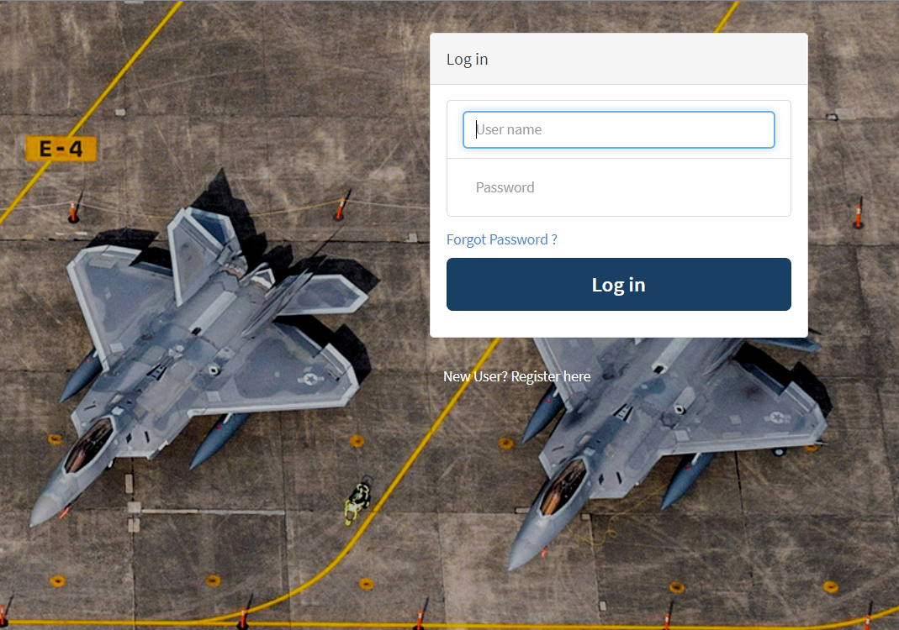
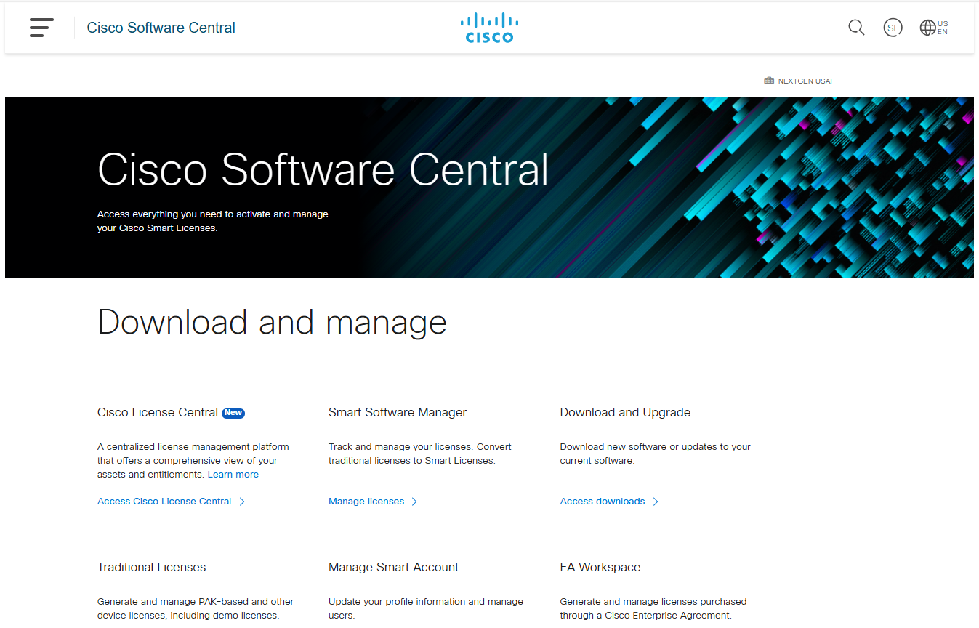
GEMSS Key Resources
Iron Bow GEMSS Website
Iron Bow Webinar Offerings
https://ironbow.com/gemss-air-force-space-force/
Software Defined Networks (SD-WAN)
Encryptions Standards
Commercial Solutions for Classified (CSfC)
Iron Bow GEMSS Licensing Portal
https://ironbow.servicenowservices.com/gemss
Once registered, portal supports:
License Generation
Virtual Account Creation
Virtual Account User Access
Catalyst Center Training
Cisco Software Central
https://www.cisco.com/site/us/en/products/networking/catalyst-center/demos.html
Cisco training videos on using the Cisco’s centralized manage tool, Catalyst Center (formerly DNA-Center).
https://software.cisco.com/
Access Cisco License Central tool
Download and manage software
Display account and user’s access
6
Notes:
Here are the GEMSS program key resources.
At the top left is the main GEMSS website where the GEMSS SOP, how-to guide, and training links are found.
The top right, Iron Bow provides many webinar offerings. A few examples are listed but our Cisco certified engineers can support any of your wicked hard problems, just ask.
In the middle right, this website is where access to virtual accounts and licenses are requested.
Looking at the bottom right, is the Cisco Software Central website, where Cisco License Central (CLC) is located. The unit’s network technician will use this link the most, for maintaining inventory, downloading software, and accessing licenses.
Should a unit consider implementing Catalyst Center or want a refresher on how Catalyst Center works, the link in the bottom left provides network technicians a great resource to understand how to implement, as well as understand all of Catalyst Center’s capabilities.

Slide 7
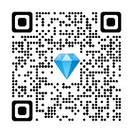
DAF GEMSS PROGRAM OVERVIEW
Global Enterprise Modernization Software & Support (GEMSS) Program Details
The Global Enterprise Modernization Software & Support (GEMSS) contract is an Enterprise Agreement (EA) that provides Cisco SmartNet coverage for all Cisco devices, Cisco Digital Network Architecture (DNA) Advantage Licenses for routers, switches, and wireless devices, and provides GEMSS white-glove support with Advanced Services. New purchases of Cisco GEMSS covered devices will have zero cost for license, software, and support services.
EXECUTIVE SUMMARY
SMART NET
DNA ADVANTAGE LICENSES
ADVANCED SERVICES
WHAT IS INCLUDED?
Technical Support
A 24x7 Technical Assistance Center (TAC) with highly qualified GEMSS personnel to assist with issues, 800-553-2447, option 1, or https://mycase.cloudapps.cisco.com/case
Device Replacement
No later than next business day replacement for all Cisco device failures.
Software Downloads
Access to the most current software and firmware for all devices through Cisco Software Central, see link below.
Network-Wide Visibility
Catalyst Center software solution that provides network discovery, inventory, Cisco PnP, software image management, audit, remediation, device tagging, and many more features, see Catalyst Center data sheet link below for complete details.
Legacy Support
Software Support Service (SWSS) offers technical support coverage for software application products included in the EN EA. SWSS coverage before 20 June 2021, was grandfathered into the GEMSS contract.
Licenses
Licenses are tracked in the Manage Licenses link located on the Cisco Software Central website.
Licenses for most Catalyst iOS-based routers and switches and Wireless AireOS and iOS devices are covered, see link below for DNA covered equipment.
High Touch Technical Support (HTTS)
Personalized, high touch support, expedited routing and call-handling with limited after-hours on-call support. Ability to transmit and receive classified information via SIPR and VoSIP. Note: Most technologies are supported 8:00 a.m.– 8:00 p.m. (Eastern).
Cisco Digital Network Architecture (DNA) Advantage license Enterprise Agreement.
SmartNet Total Care
SmartNet Total Care support that provides technical support 24x7. Defective device replacement no later than next business day. Cisco software downloads for all Cisco devices, and Cisco Catalyst Center software to centrally manage the Cisco device ecosystem. Grandfathered coverage for all Cisco Software Support Service (SWSS) coverage.
DNA Advantage Licenses
Smart Account licensing is provided for most Catalyst routers, switches, and wireless devices.
Advanced Services
Five Cisco engineers and architect to support AF-level engineer solutions. Cisco engineers with clearances to provide units personalized support for NIPRNet, SIPRNet, JWICS device issues.
GEMSS@IronBow.com
High Touch Operations Management (HTOM)
Cisco single point of contact for all support assistance, prioritization and management within this contract.
afhtom@cisco.com
SUPPORT
Metrics
The GEMSS Team provides discussions with management and performance metrics to CCMD, HAF, MAJCOMs, FLDCMDs, and Units to ensure the DAF maximizes use of all services and capabilities.
Additionally, all Units can access Cisco License Central through Cisco Software Center for a list of assigned device, see link below.
Advanced Service Resources
Five dedicated Cisco resources to support design, implementation, delivery and management of the Cisco environment.
Asset Management
Cisco resources to track, maintain, and document Cisco hardware and software.
afassetmgr@cisco.com
Contract Details: 1 Base Year with 4 option years (Contract # 204246961)
Start Date: 25 June 2021 End Date: 23 April 2026
Iron Bow GEMSS website: https://ironbow.com/gemss-usaf-space-force
Key Resources:
DNA covered equipment | Cisco Software Central
Catalyst Center info | Cisco Device End of Life notices
Notes:
This slide is a one-page slick sheet that summarizes the GEMSS program. The QR code at the top right is a link to the main GEMSS resource website. Links to the key resources are located at the bottom left, and the main GEMSS website link is located at the bottom right.
Remember, New purchases of Cisco devices covered by the GEMSS program will have zero cost for the license, software, and support services. If unsure, please contact the GEMSS Team for verification.
Additional Information
============================
SmartNet Total Care:
24 hours x 7days Technical Assistance Center availability (800-553-2447, Option 1)
TAC cases are opened for technical issues with any Cisco banded device
- 8 hours x 5 days/week, next business day replacement for all Cisco devices
- Grandfathered coverage for legacy SWSS (software support service) devices
Cisco Software Central:
Provides Route, Switch, and Wireless software for all Cisco Devices (including Nexus devices)
Provides Catalyst Center software to centrally manage, monitor, and configure Cisco devices
Does Not provide software like ThousandEyes or Meraki software
Cisco License Central (CLC):
Provides units access to a database of:
Devices assigned – useful for inventory management
When devices reach Last Day of Support (LDOS) – when a device will no longer be supported by Cisco for repair/replacement
Cost of devices, useful for POMing drills
List of device licenses
Identifies over or under usage for devices assigned
DNA Advantage License
The GEMSS program does NOT provide Nexus NexOS device licensing
Licensing is provided for Cisco iOS Catalyst and AireOS wireless devices
See DNA Covered Equipment link for list of devices covered by DNA Licensing
Advanced Services:
- HTTS – High touch technical support with the ability to transmit and receive classified information
- HTOM – Single point of contact for all support (TAC case assistance)
- Five Cisco Network Engineers and Architect for support and implementation of DAF-wide solutions

Slide 8

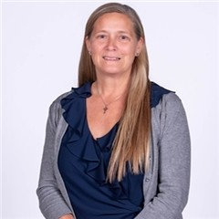


GEMSS Team
    Steve Esposito
    GEMSS Director
    Stephen.esposito.1.ctr@us.af.mil
    stephen.esposito@ironbow.com
    571-324-1371
    Dave Morrisette
    GEMSS Service Delivery Leader
    dmorrise@cisco.com
    210-286-2992
    Kelly Taylor
    GEMSS Cust Success Manager
    kelly.taylor@ironbow.com
    240-487-2196
    Monica Guevara
    GEMSS Operations Manager
    monica.guevara@ironbow.com
    210-612-4501
    Mike Hart
    GEMSS Engineer
    michael.hart@ironbow.com
    703-674-5229
    Mike Lydo
    Senior Manager, Software & Adoption Services
    mike.lydo@ironbow.com
    716-515-8547
GEMSS@IronBow.com
Notes:
This is a list of each person on the GEMSS Team, and the main point of contact when units have Cisco questions or concerns is Mr. Steve Esposito. Thank you for your time today, and I hope this brief helped you understand the GEMSS program better.

