Slide 1

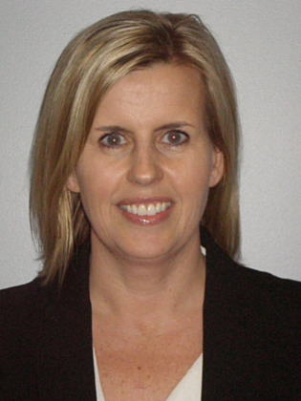
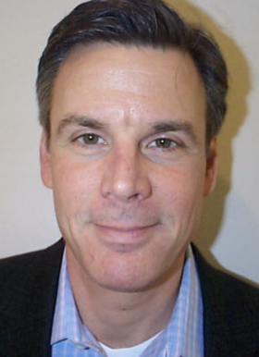
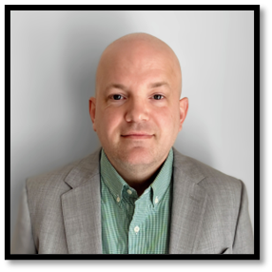
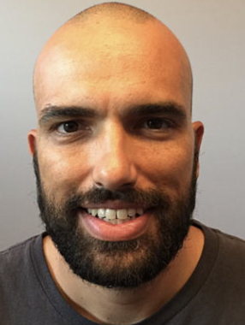
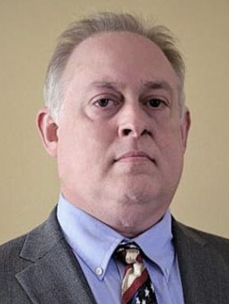
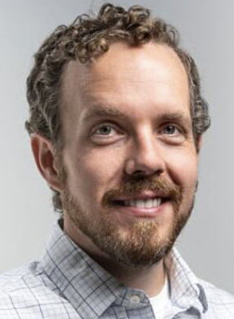
Cisco Support for DISA – Customer Experience
Account Team
Customer Experience
Arlene Gately
Director, Customer Experience
Bob Corbitt
Client Services Executive
Charles Hood
Customer Experience Manager
Hugo Zanzi
High Touch Operations Manager
Dale Dressler
Project Manager
Chris Garret
Client Operations Delivery Analyst
Notes:
Example how to introduce the team members as it relates to their function with the customer
To replace circles labeled add pic, suggest right click > Format Shape > Picture of texture fill > from clipboard (use snagit/screenshot to capture a perfect square photo)

